Slide 1
Autonomous Vehicle Control Using Google Maps API
Vignesh N( 211420105338 )
Vinay K R( 211420105339 )
Tharan Roy( 211420105334 )
Madhavkannan N( 211420105315 )
Guided By
Dr.D.Silas Stephen

Slide 2
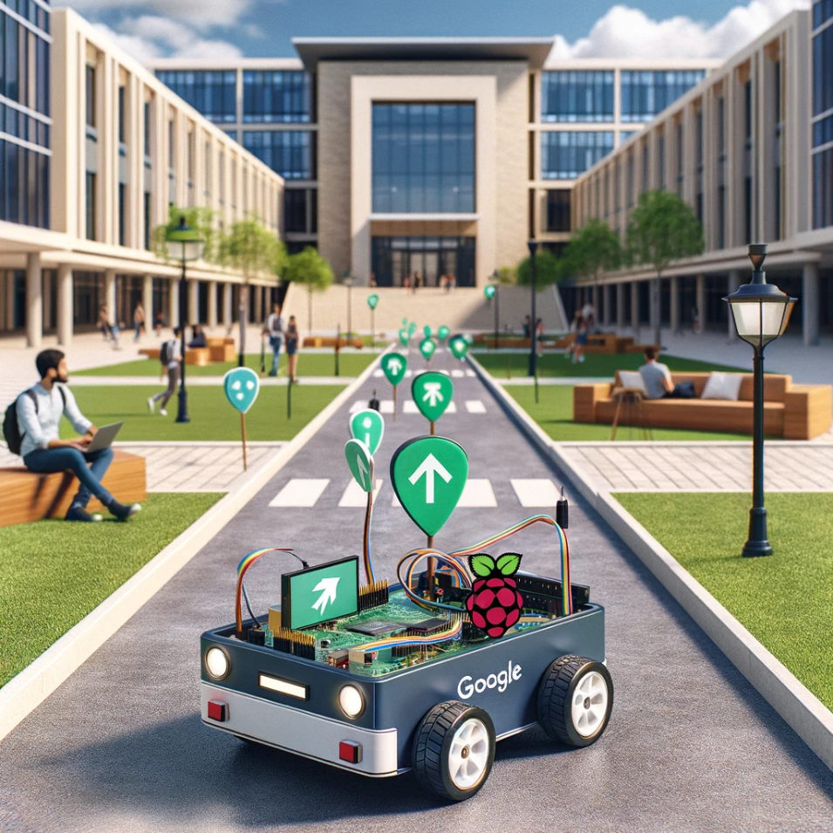
Abstract
This project aims to develop an autonomous miniature vehicle capable of navigating between specified points within a predefined environment, such as a college campus.
Utilizing the Google Maps Directions API, the vehicle receives real-time directions, including distances and turn-by-turn instructions, to autonomously travel from an origin point to a destination, such as from a department building to a mess hall
The core of the project involves interfacing the Google Maps API with a Raspberry Pi, which serves as the vehicle's central processing unit.
The Raspberry Pi, equipped with Python programming, interprets the API's directional data and translates it into actionable commands for the vehicle's motor control system.

Slide 3
Objectives
To Make an Self Driving Electric vehicle
Moving from 2 points without manual control
Drawback of Existing Method
Lacks latest technological features
Manual control only
Pros of Proposed Method
Cost Efficiency: The method contributes to cost savings, either through more efficient energy use, reduced maintenance needs.
Enhanced Performance: The method might improve overall vehicle performance, addressing issues such as acceleration, braking, and handling associated with electric vehicle design.

Slide 4

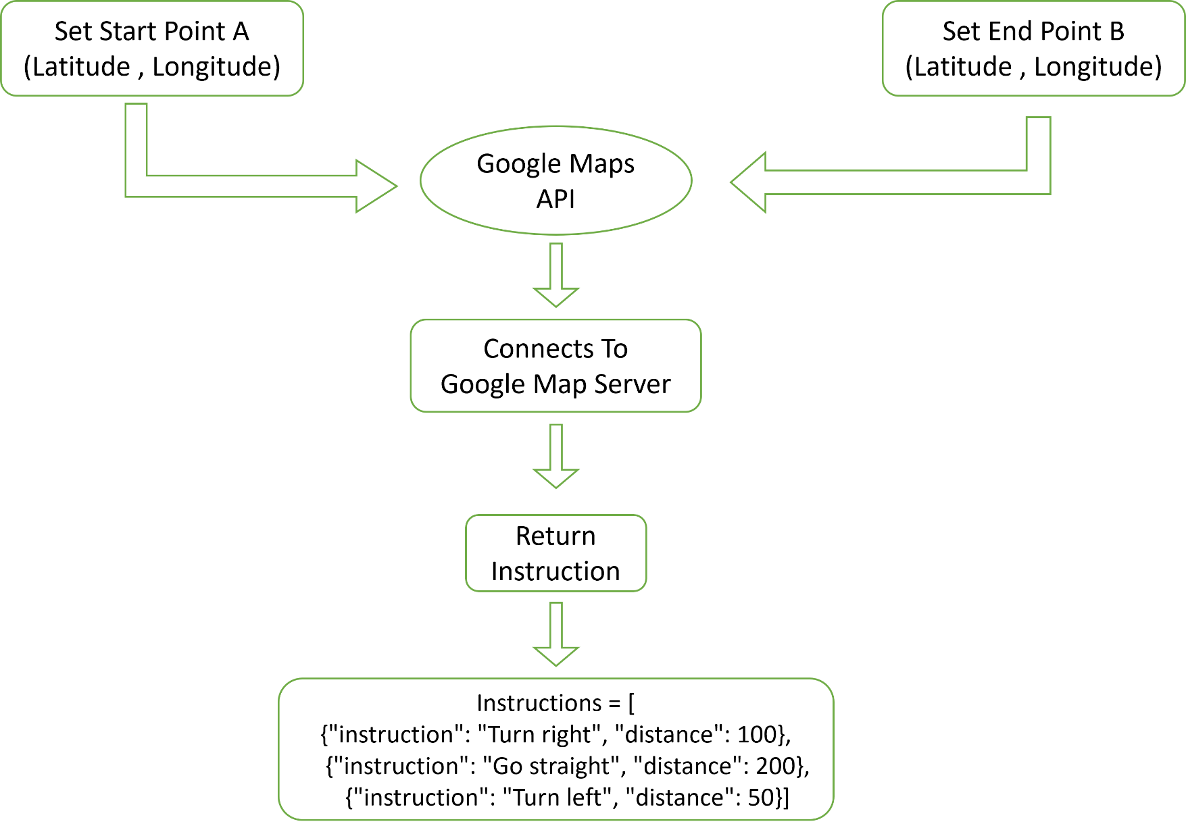



MODULE 1

Slide 5
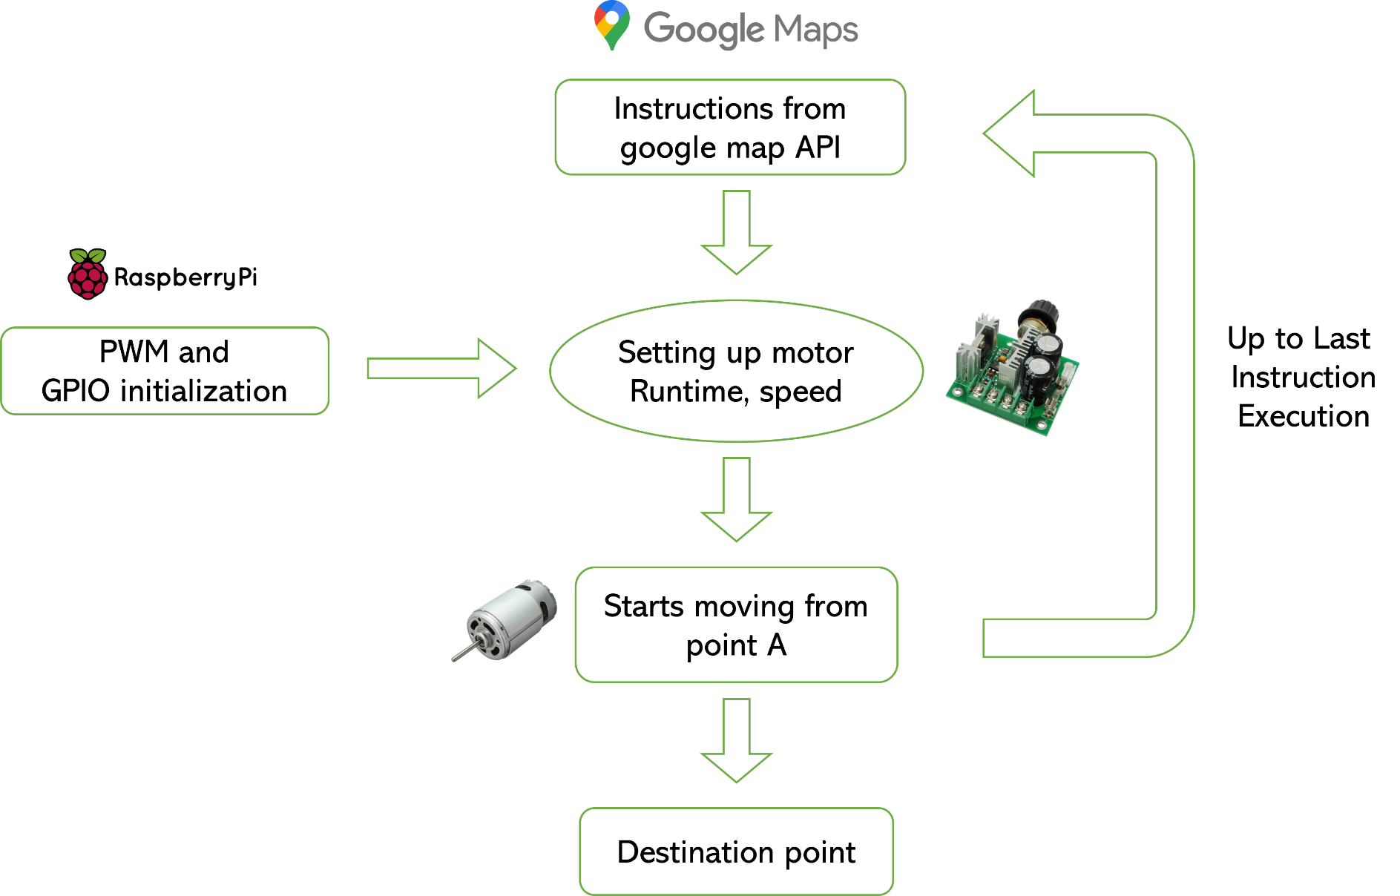
MODULE 2

